Slide 1


Rating Prediction Project
By – Santosh Reddy

Slide 2
Problem statement
We have a client who has a website where people write different reviews for technical products. Now they are adding a new feature to their website i.e. The reviewer will have to add stars(rating) as well with the review. The rating is out 5 stars and it only has 5 options available 1 star, 2 stars, 3 stars, 4 stars, 5 stars. Now they want to predict ratings for the reviews which were written in the past and they don’t have a rating. So, we have to build an application which can predict the rating by seeing the review.
But first You have to scrape at least 20000 rows of data. You can scrape more data as well, it’s up to you. more the data better the model In this section you need to scrape the reviews of different laptops, Phones, Headphones, smart watches, Professional Cameras, Printers, Monitors, Home theater, Router from different e-commerce websites.

Slide 3
Basically, we need these columns-
1) reviews of the product.
2) rating of the product.
You can fetch other data as well, if you think data can be useful or can help in the project. It completely depends on your imagination or assumption.
Try to fetch data from different websites. If data is from different websites, it will help our model to remove the effect of over fitting. Try to fetch an equal number of reviews for each rating, for example if you are fetching 10000 reviews then all ratings 1,2,3,4,5 should be 2000. It will balance our data set. Convert all the ratings to their round number, as there are only 5 options for rating i.e., 1,2,3,4,5. If a rating is 4.5 convert it 5.

Slide 4
After collecting the data, you need to build a machine learning model. Before model building do all data preprocessing steps involving NLP. Try different models with different hyper parameters and select the best model.
Follow the complete life cycle of data science. Include all the steps like-
1. Data Cleaning
2. Exploratory Data Analysis
3. Data Preprocessing
4. Model Building
5. Model Evaluation
6. Selecting the best mode

Slide 5
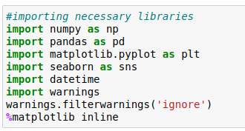
Importing the necessary libraries
We are going to import necessary libraries to use in the project
We imported some of the libraries that are mainly useful for analyze the data set,there are other libraries which will be imported in the flow of project, some are useful for statistical analysis and some are useful for visualization

Slide 6
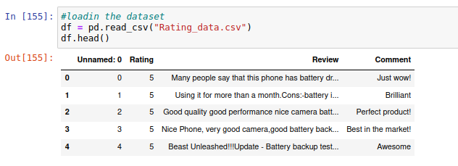
Importing the data set
Now we have to import the data set in pandas we have read_csv function in the pandas to load the data set
We need to edit both the files as there will be null values in the dataset
We have imported the the data set lets check the shape of the data set and it has any null values

Slide 7
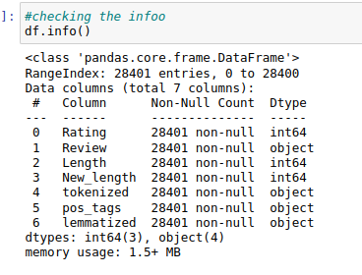
Exploratory Data Analysis
This is the step where we are going to analyze and represent dataset in visual way and we have to see if there is any pattern in the data so we have to use them for feature engineering
Lets stat with shape and
information of data-set in
pandas we have .shape
and .info() methods which
shows us information and
shape of the data

Slide 8
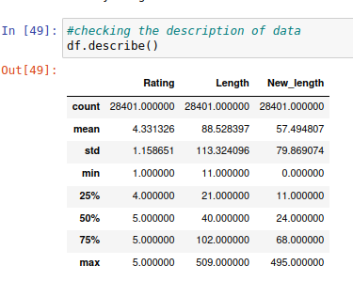
Describe function in pandas helps in the to get details about the statistical data like mean, median, std and percentiles of the data

Slide 9
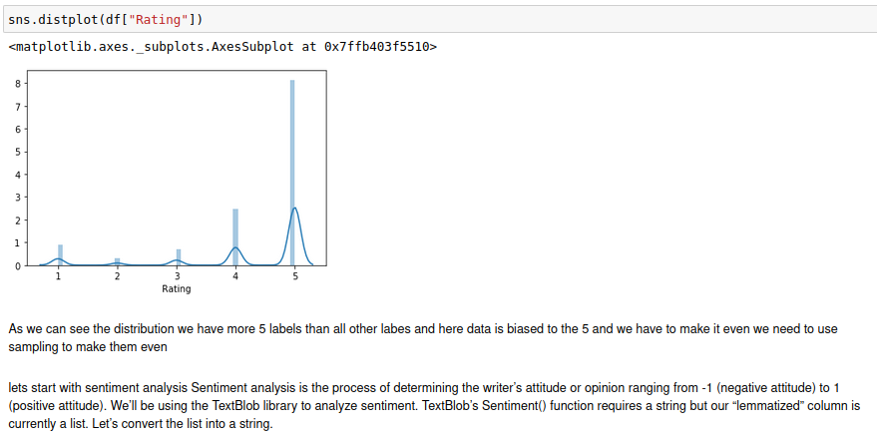

Slide 10
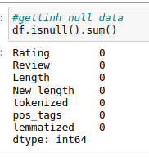
We have to check the null values in the data set, in
pandas we have .isnull() method to see the null values
in this data set we don't have any null values
Lets proceed further
When come to the visualization we have some
visualization libraries we have used in this project are
Matplotlib
Seaborn
yellow brick

Slide 11
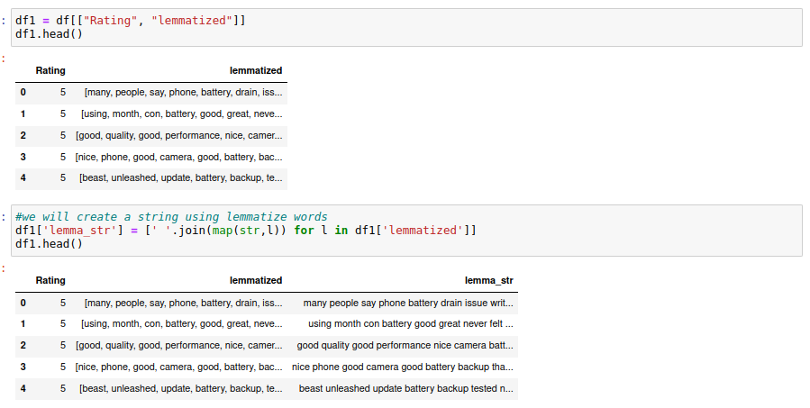
Here I am create first I word tokenized the and then we lematized the string so thet we can draw insights
To make good visualizations from the columns

Slide 12
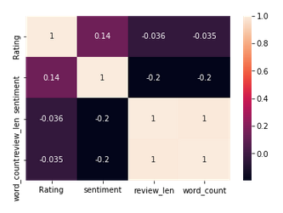
For visualization I have used matplotlib, seaborn, yellow brick , visualization is most important part of machine learning project as it tells us about the
Mainly if want to check the multicolinerarity or correlation and relation with the target variable we will be using visualizations I will display some of them
This is heatmap we will be
using for checking null vals
and correlation between
variables and target variables

Slide 13
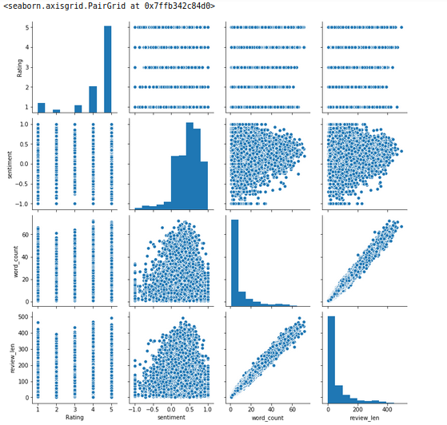
We see the distribution of the dataset weather it is properly distributed or not by the help of the pairplot

Slide 14
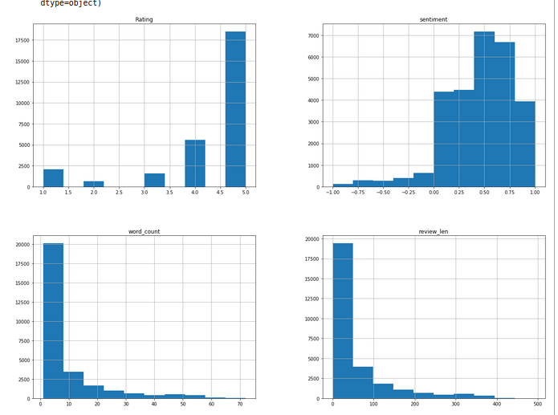
Here we are seeing hist plots which shows us the data distribution and also the the way the data is distributed and it is most in model building, If data is distributes normally then there is no problem otherwise we have to make it normalize with methods liks log normal distribution

Slide 15
Correlation:
Correlation is defined as relation between two variables on how data is influenced by the change of another variable so lets check that
We will use it to know the relation between the other variables to target variable
Outliers:
Actually it is NLP text based project
so we are not using any outlier
methods in the data

Slide 16
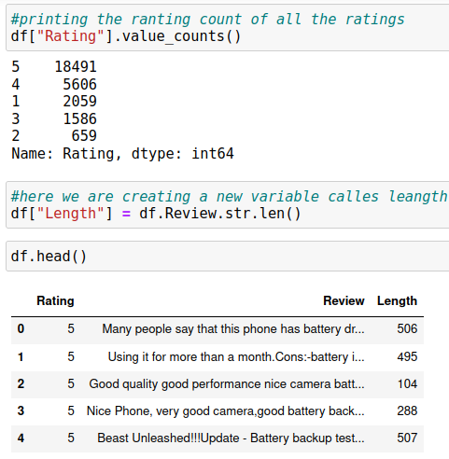
Text Preprocessing
Test prepossessing is very important step in the NLP project where we have to make the string ready for the model we will do certain things like removing all things from the strings like numbers, punctuation, symbols and any noise that is present in the string
Lets start with checking the value counts where
need to find occurrence of target variables
then I find the length of each string by creating
a variable

Slide 17
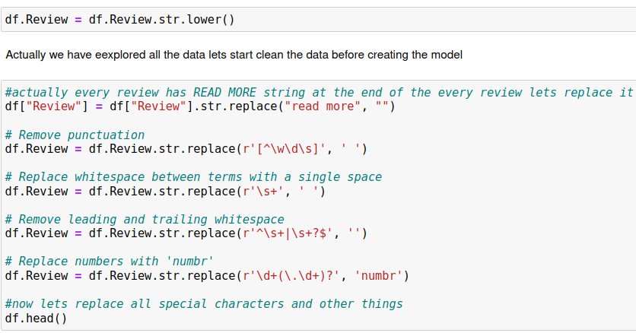
In this we are all string to lower case and then we are removing all the unwanted white noise in the data

Slide 18
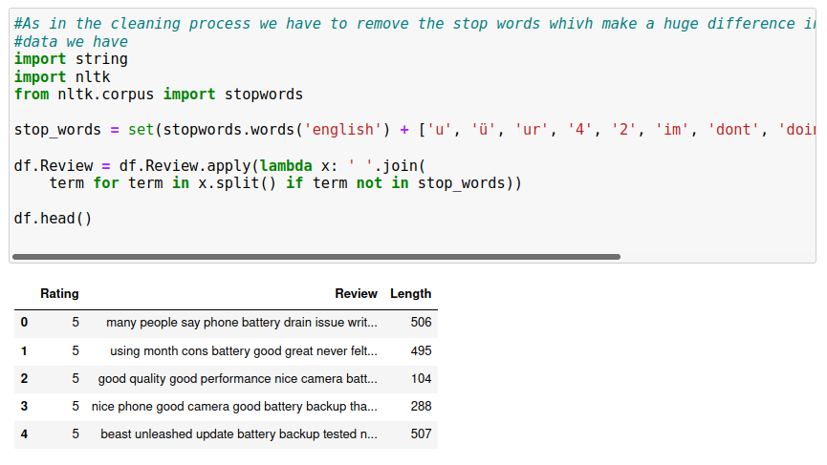
We have removed all the stopwords which are considered to be white noise

Slide 19
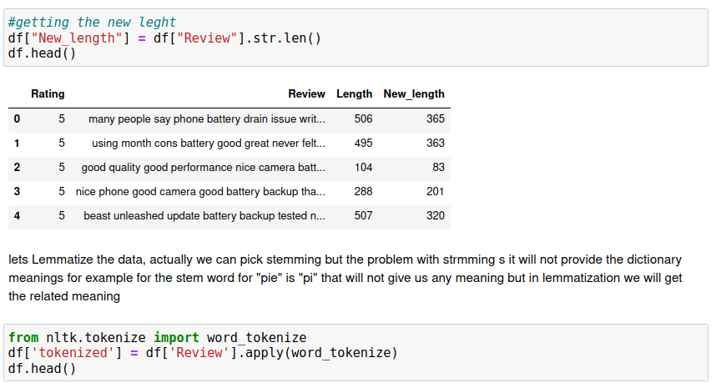
We have removed all stop words and we also tokenize the words, so now we have to lemmatize the those word tokenized strings

Slide 20
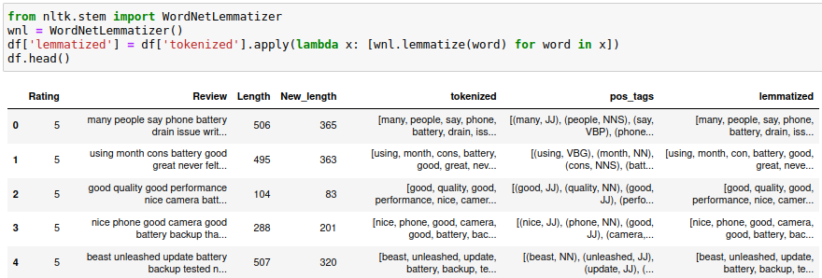
Here we can see that we have done pos-tagging along with the lemmatization . Post-tagging is nothing but we are deriving the parts of speech from the data and stored in the dataframe

Slide 21
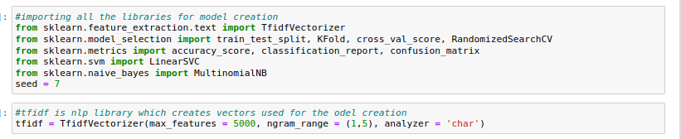
Model creation
Her I am using Linear SVC and Multinomial NB for classification so that we can predict the rating
At first we need to import all the metrics and other things to get startes
Here we have used TFIDF for vectorizing the string so that we can introduce in the model

Slide 22
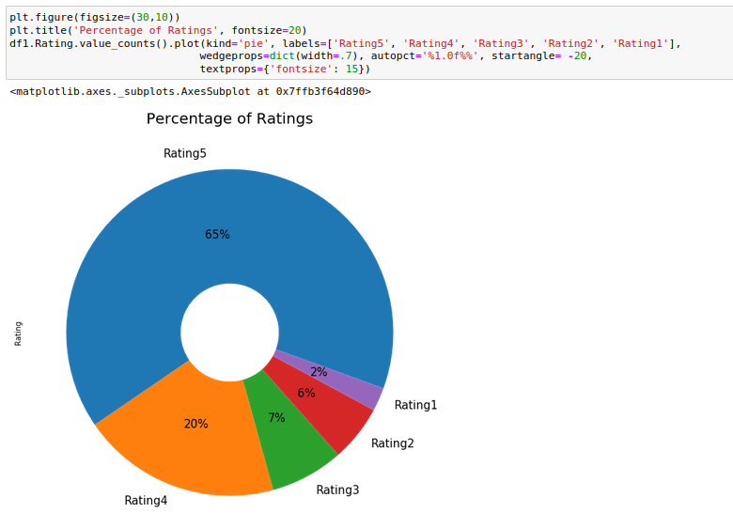
We an see the percentage of the labels in the dataset
We can see
there is a much
of biased to 5 rating
we have to make
them balanced

Slide 23
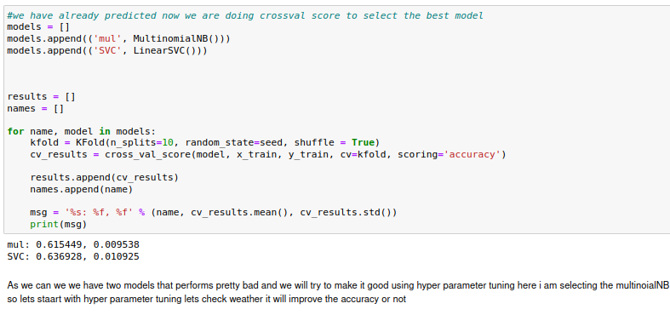
Checking the Cross Val Score
Before creating the model we have to check the cross val score to make sure that
Cross-validation is a technique in which we train our model using the subset of the data-set and then evaluate using the complementary subset of the data-set.

Slide 24
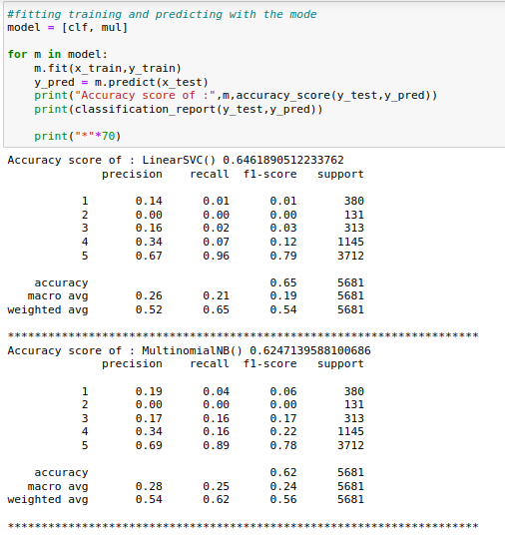
Model Creation
In this step we start using a set of a set of algorithms we need to create the model and them we need to predict the test data
We have used

Slide 25
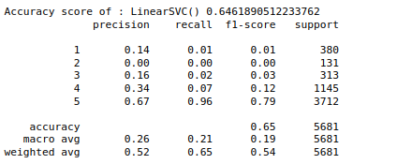
Accuracy
After creation of model we have to hve to check the accuracy of the model
We have to make a note of
accuracy, f1score
precission
these are important metrics
that defines the models
acuracy

Slide 26
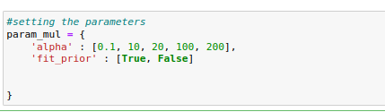
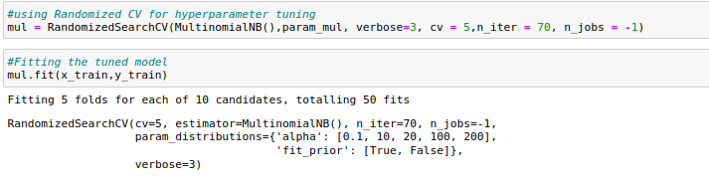
There is a littledifference between cross val-score and normal prediction score so i am gonna pick one best model for performing hyper parameter tuning and saving the model, here I am picking multinomial NB model and started with hypert parameter tuning here I am using hyper parameter tuning for all the models
In hyper parameter tuning we will tune the best model with change of paramters so that we will achieve good results

Slide 27
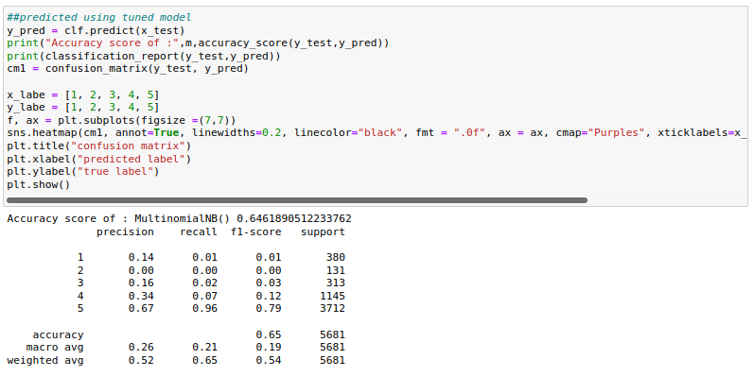
Now fitting the tuned model(Multinomial NB)

Slide 28
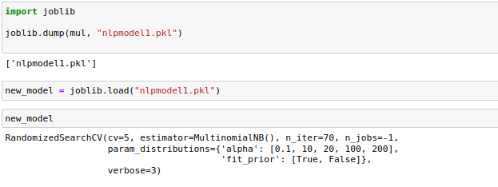
Saving the model
We are going to save the model using a library called joblib with the extension of
.obj or pkl

Slide 29
Conclusion
So after all those steps in the in creating model we have finally achieved an accuracy of 64 percent, and we have saved model for further use, we have tested the model on some metrics like hype parameter tuning etc, didn't use pair plot as there are more columns it will take more time

